Slide 1
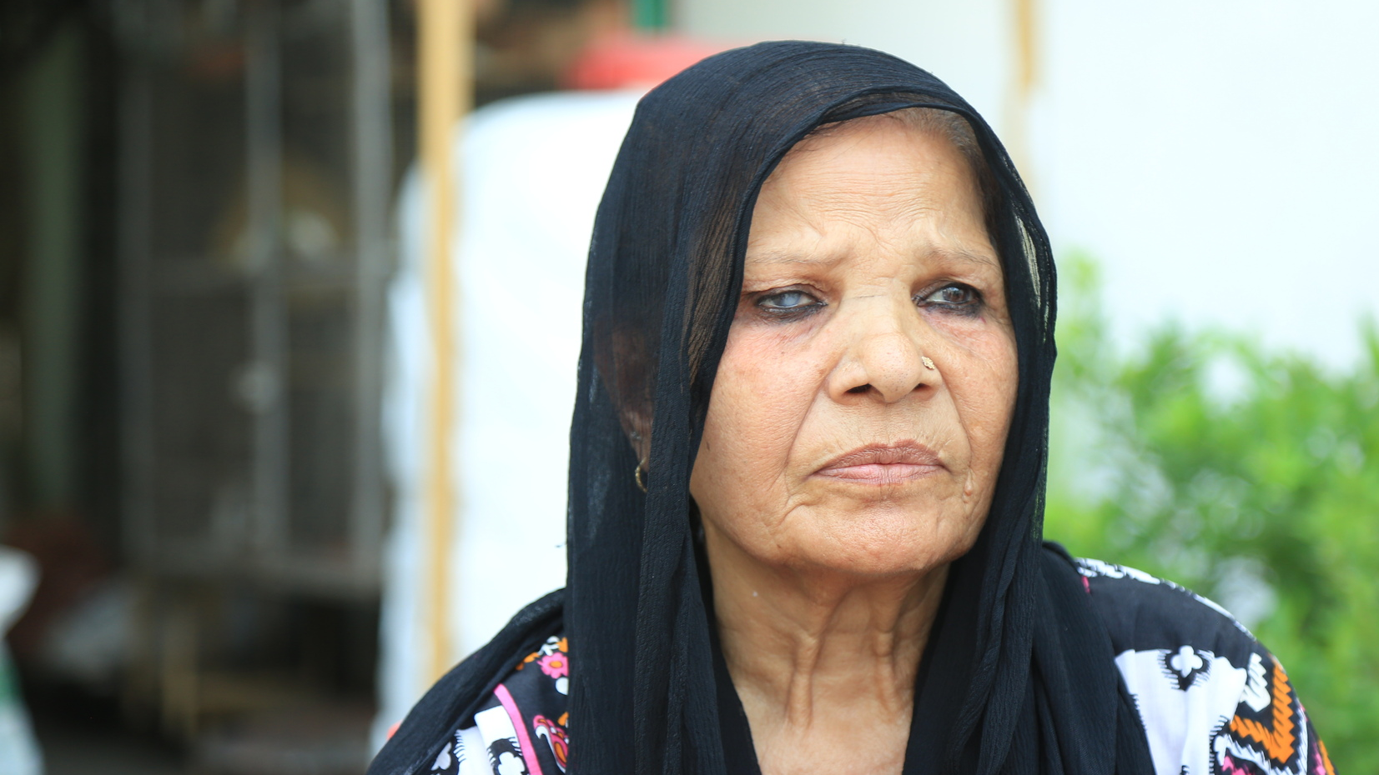
IDOP 2023
HELPING PRISONERS
OF FAITH AND THEIR FAMILIES

Slide 2
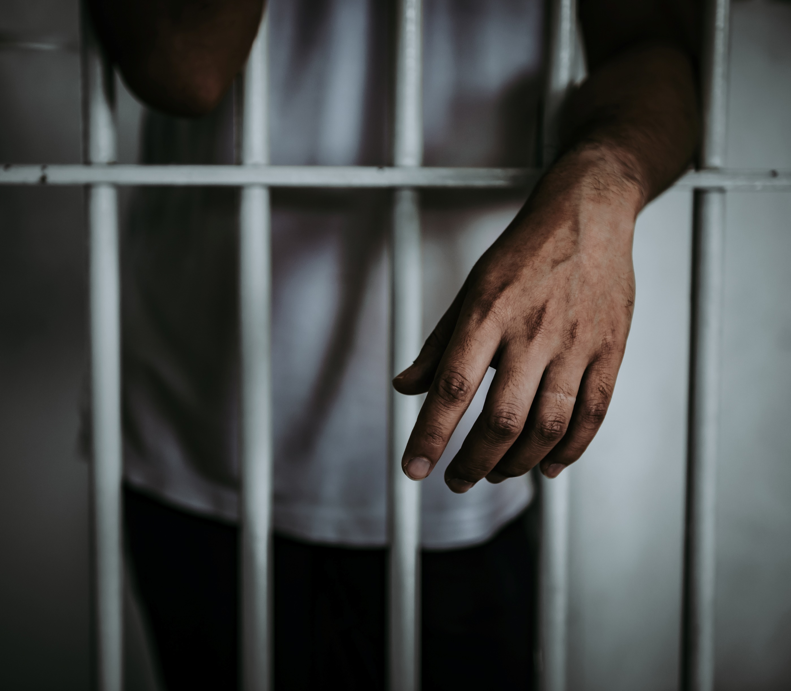
HELPING PRISONERS OF FAITH
Being imprisoned for your faith means:
suffering injustice
losing your freedom
being separated from family/church
facing mistreatment from prison authorities and inmates.
Notes:
Small image slide with title and text. All fonts to be Impact or Cambria. Don’t change font size – use multiple slides if required.

Slide 3
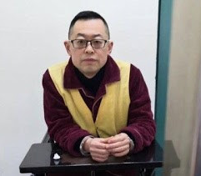
PASTOR WANG YI | CHINA
Pastor Wang Yi is the influential leader of Early Rain Covenant Church in Chengdu, China. After refusing to conform to the Communist Party’s restrictive new religious laws in 2018, he was arrested and sentenced to 9 years for ‘inciting subversion of state power.’
Since his arrest his family and church have been monitored and harassed by state officials.
Notes:
Small image slide with title and text. All fonts to be Impact or Cambria. Don’t change font size – use multiple slides if required.

Slide 4
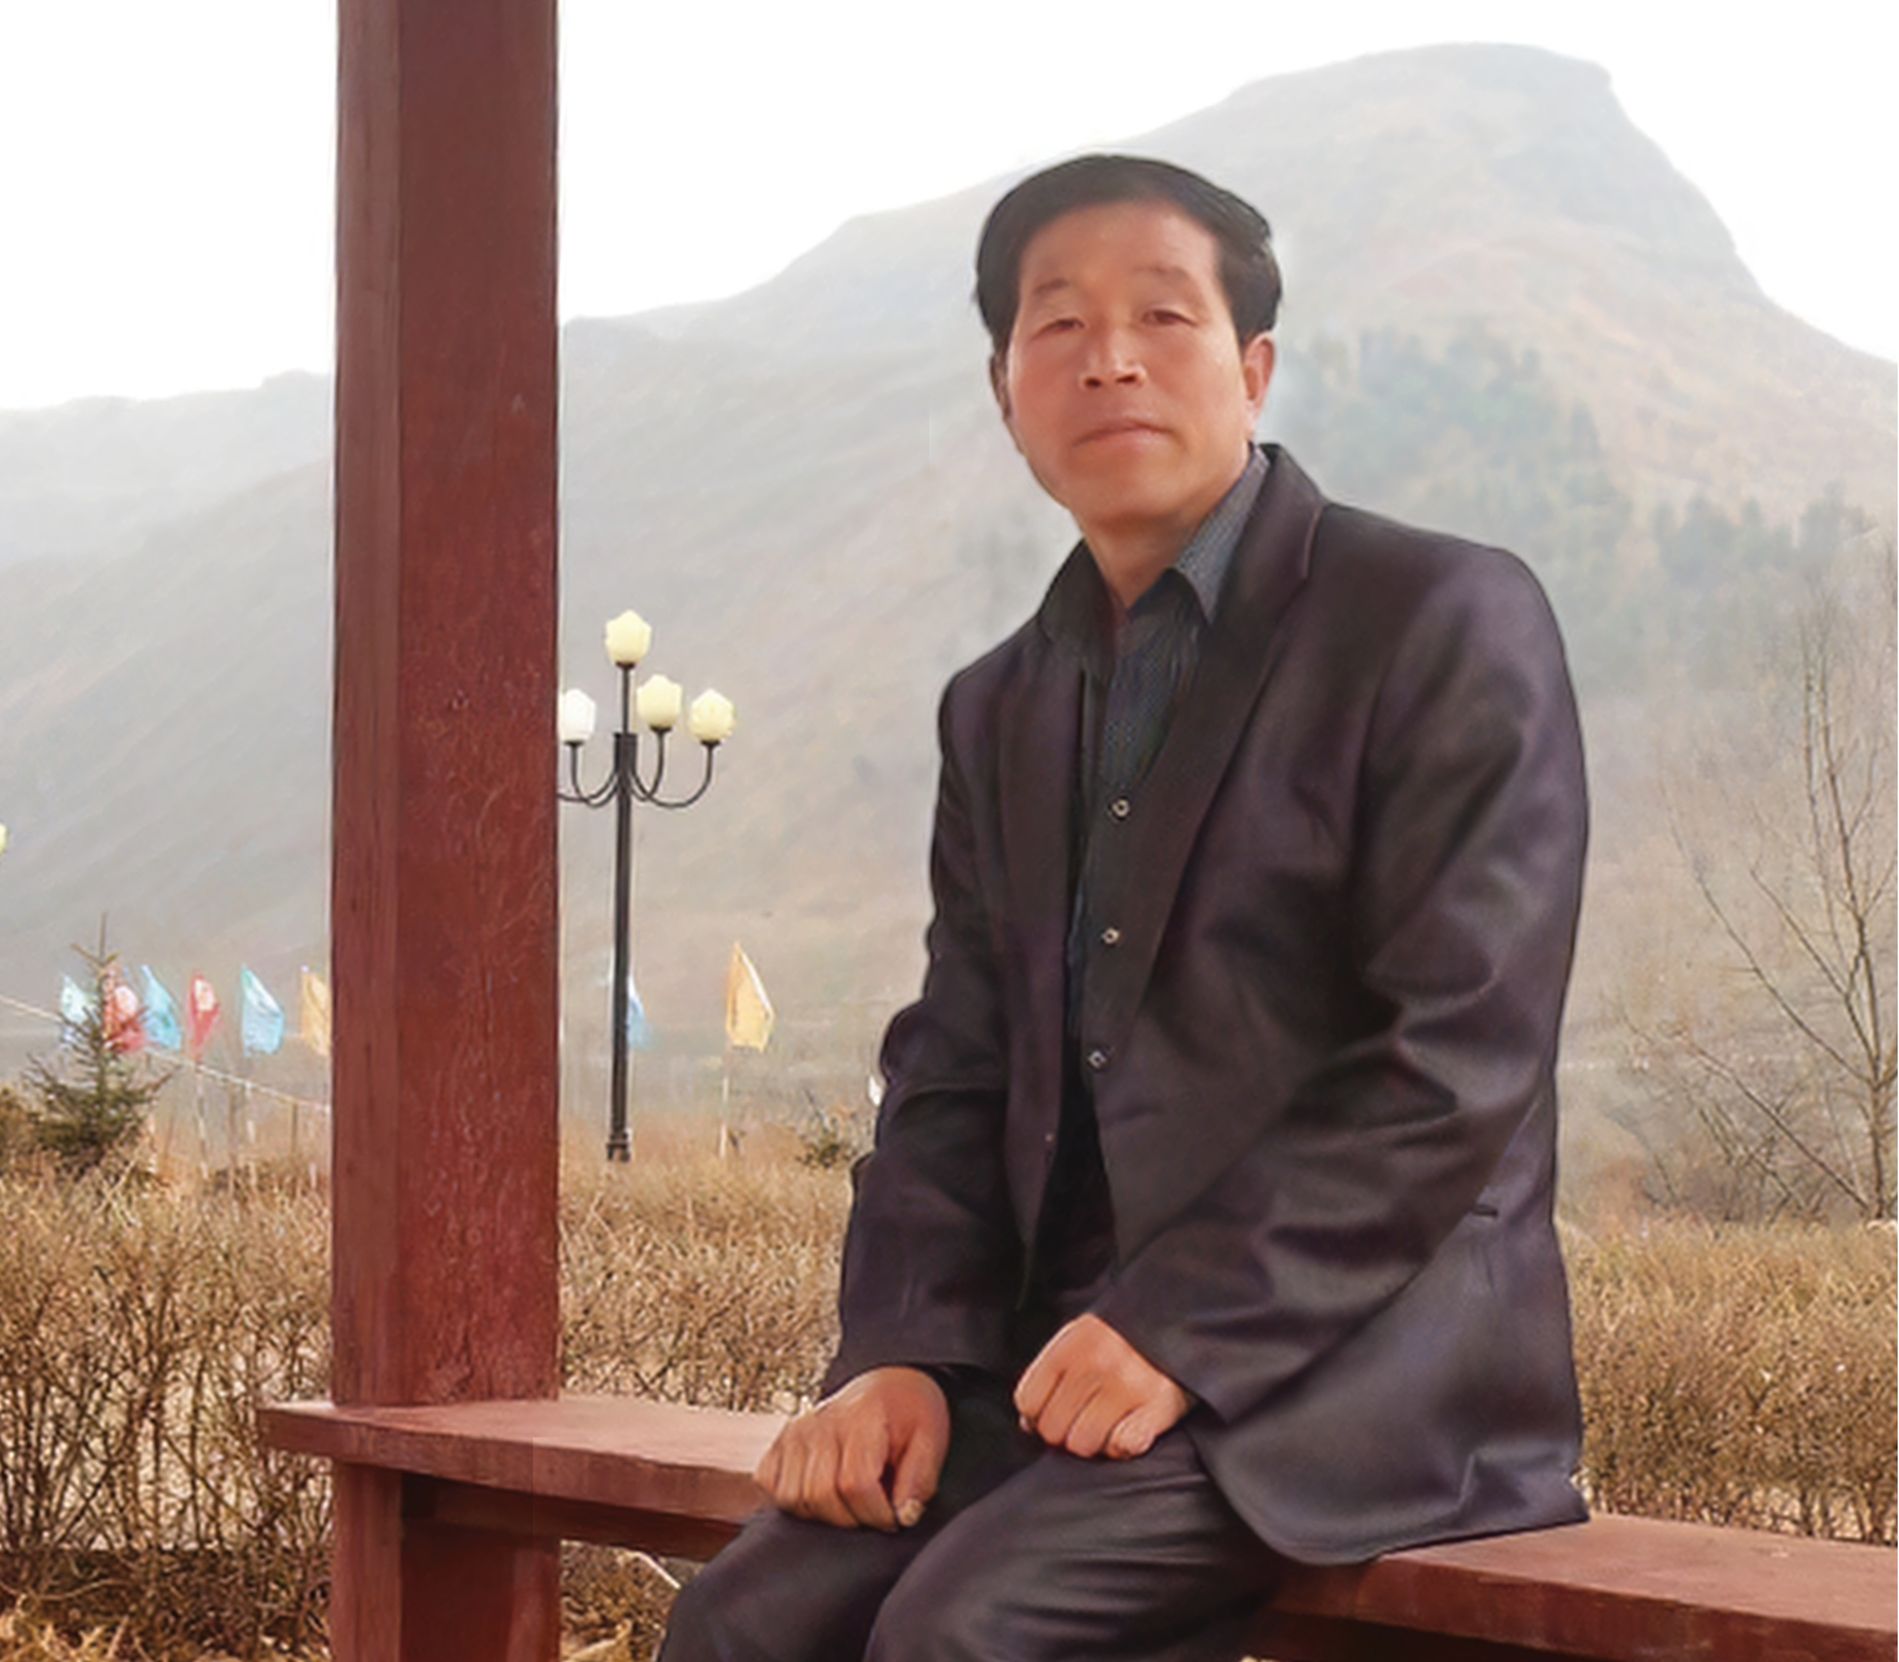
DEACON JANG | NORTH KOREA
Deacon Jang lived in China near the border of North Korea. He provided food, clothes, and supplies to North Koreans who visited his town. He also shared his faith with those who were willing to listen and some became Christians.
In November 2014 he was kidnapped and sentenced to 15 years in a North Korean prison.
Notes:
Small image slide with title and text. All fonts to be Impact or Cambria. Don’t change font size – use multiple slides if required.

Slide 5
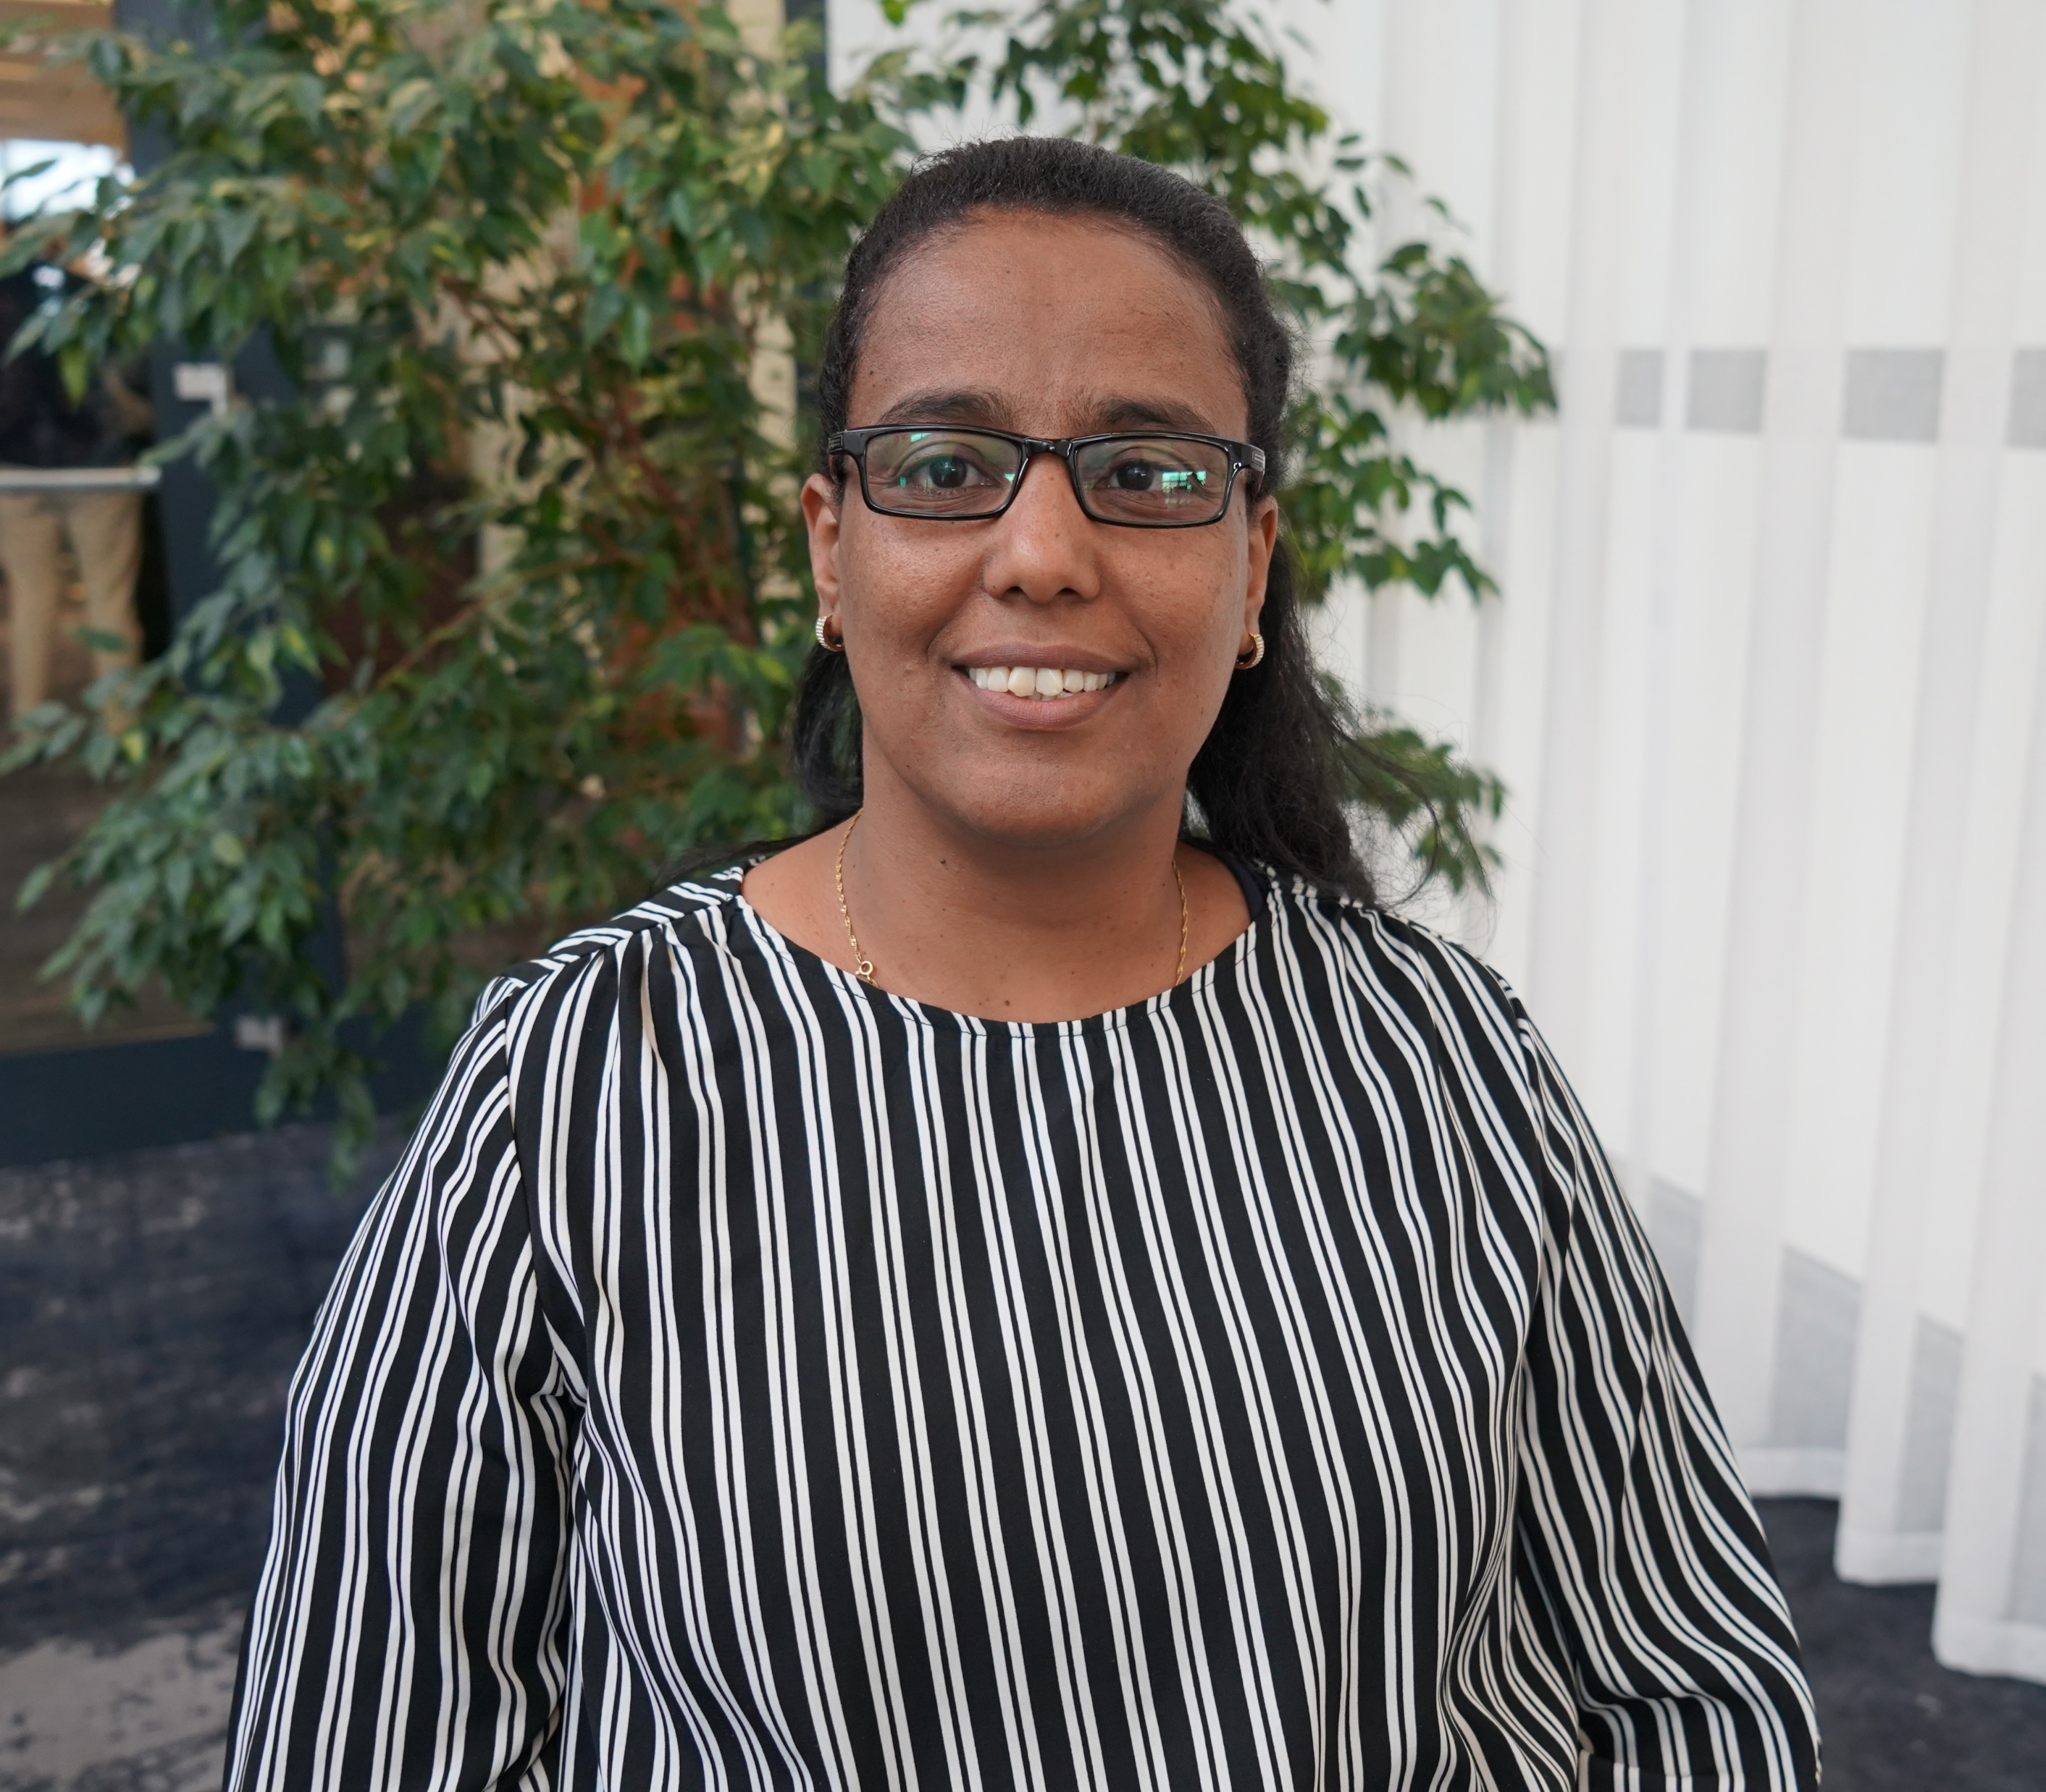
TWEN TEDROS | ERITREA
Twen spent a total of 16 years in prison after refusing to deny her faith. She was kept in a metal shipping container and was repeatedly beaten and tortured.
However, God sustained her faith. Following her recent release she said, ‘The grace of God made everything possible. I feel so blessed to participate in Christ’s suffering.’
Notes:
Small image slide with title and text. All fonts to be Impact or Cambria. Don’t change font size – use multiple slides if required.

Slide 6
BIBLE TEXT | GENESIS 39 - 40
‘Joseph said to [the chief cupbearer] …when all goes well with you, remember me and show me kindness; mention me to Pharaoh and get me out of this prison. I was forcibly carried off from the land of the Hebrews, and even here I have done nothing to deserve being put in a dungeon.’
Genesis 40:14-15
Notes:
Bible passage slide with small image if required. Don’t change font size – use multiple slides if required. All fonts to be Impact or Cambria.

Slide 7
HELPING PRISONERS OF FAITH | PRAY
For all those who are imprisoned because of their faith in China, Eritrea, Iran, Pakistan and North Korea.
For the families of Christian prisoners who often face harassment, ostracism, and deprivation.
For Christian pastors and church leaders who have been given long sentences, like Wang Yi and Deacon Jang.
For Release International’s partners in various places who are serving prisoners of faith and their families.
For Christians in the UK to actively remember our brothers and sister who are in prison.
Notes:
Bible passage slide with small image if required. Don’t change font size – use multiple slides if required. All fonts to be Impact or Cambria.

Slide 8
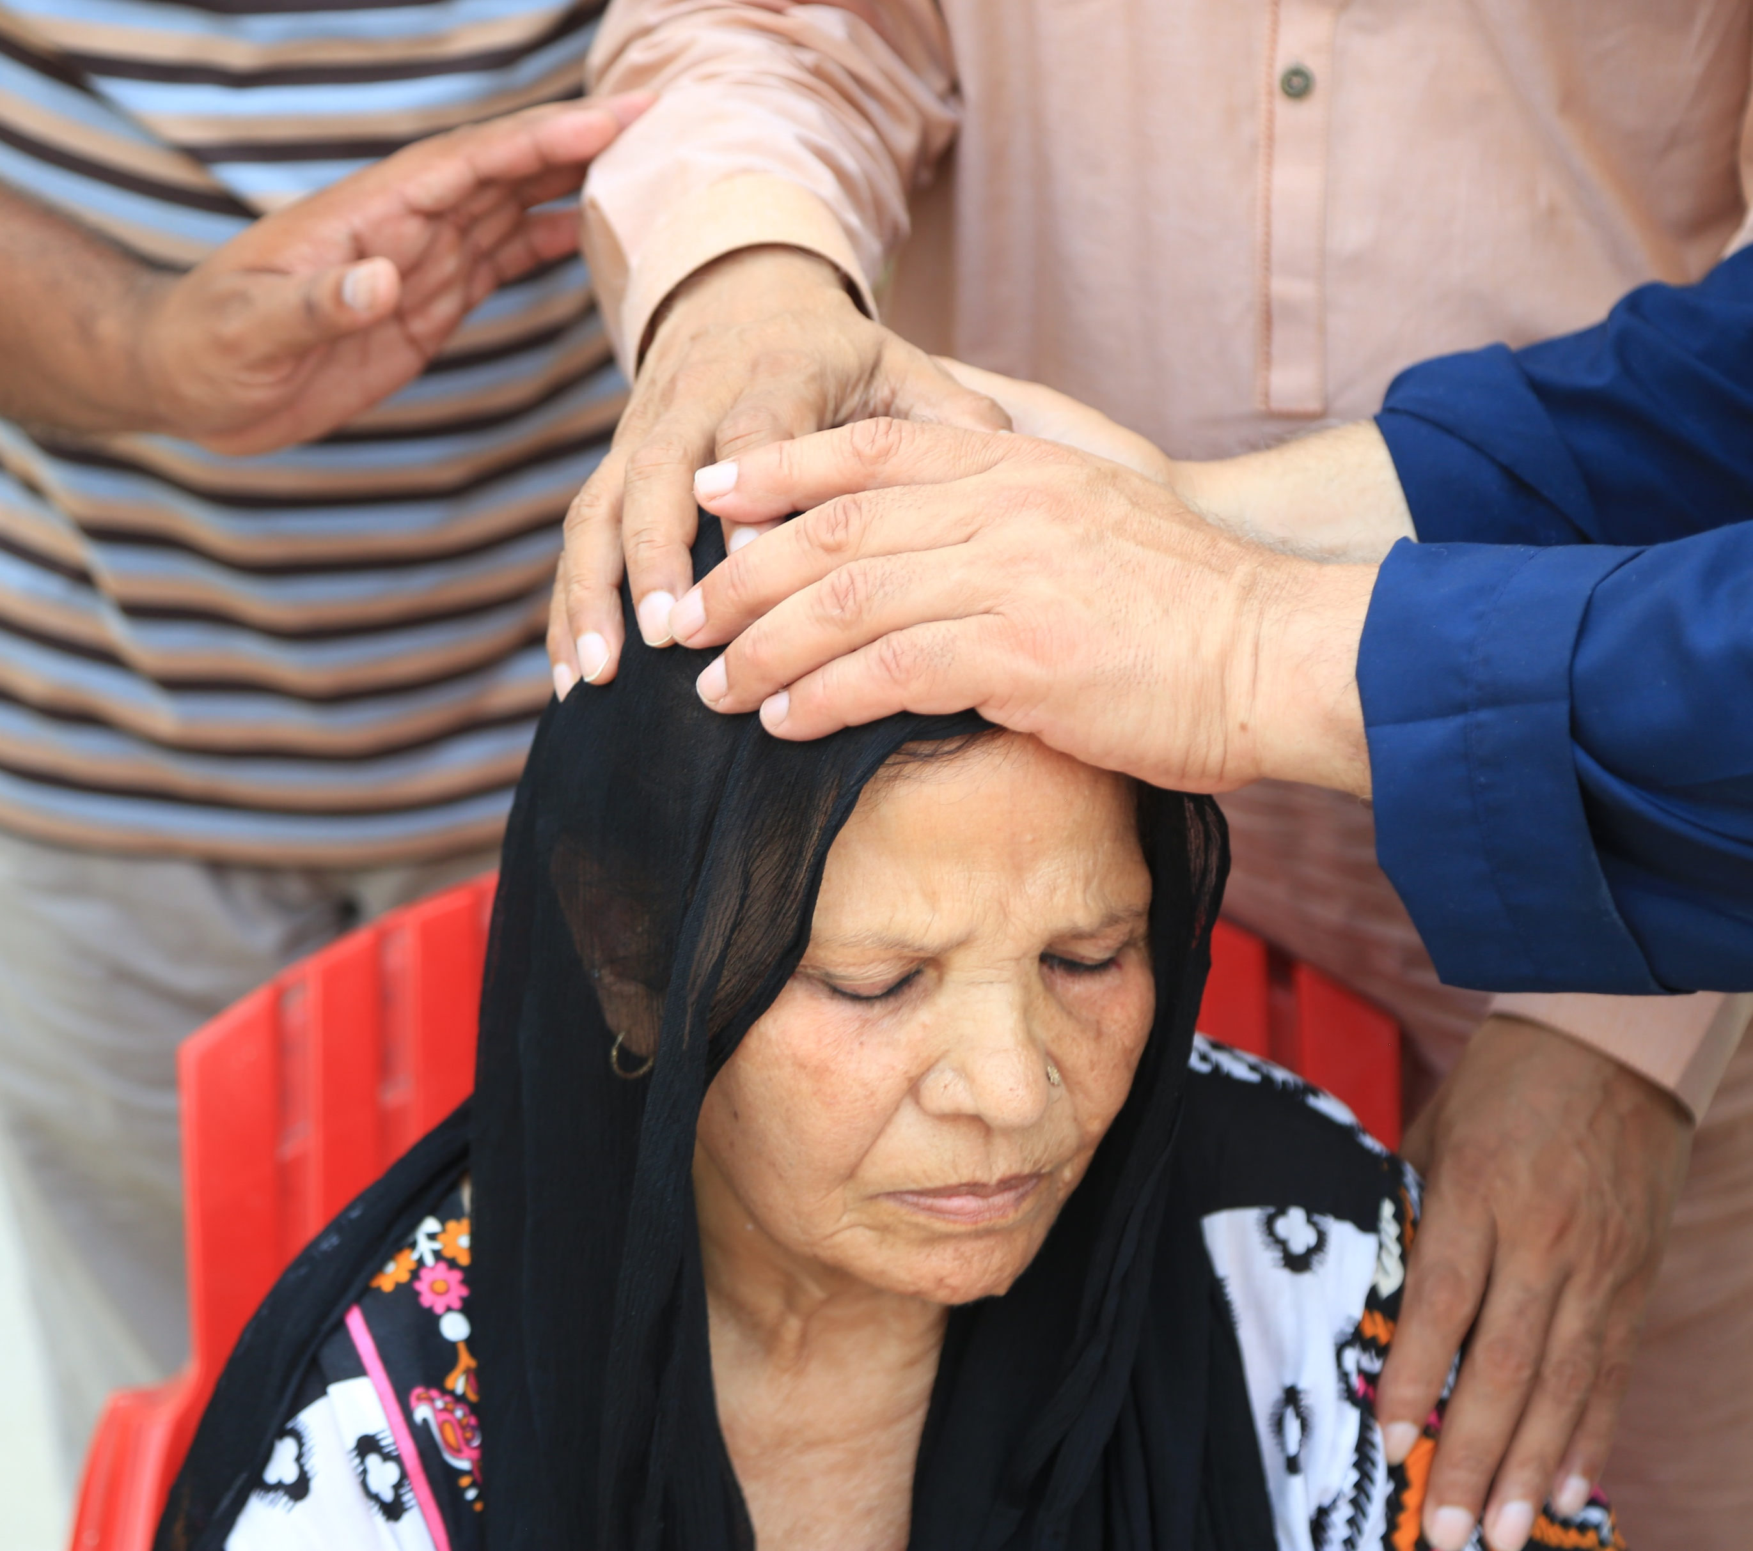
HELPING PRISONERS OF FAITH
Through our network of international partners Release International is helping to support Christian prisoners of faith and their families with legal aid, practical provisions, and pastoral care in several countries across the world.
Notes:
Small image slide with title and text. All fonts to be Impact or Cambria. Don’t change font size – use multiple slides if required.

Slide 9
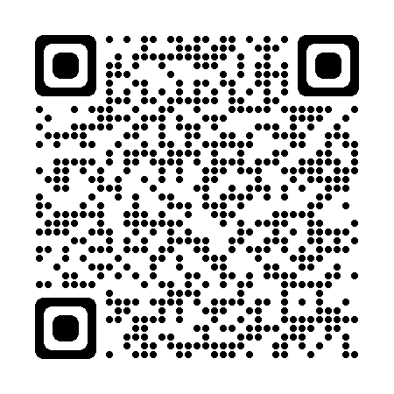
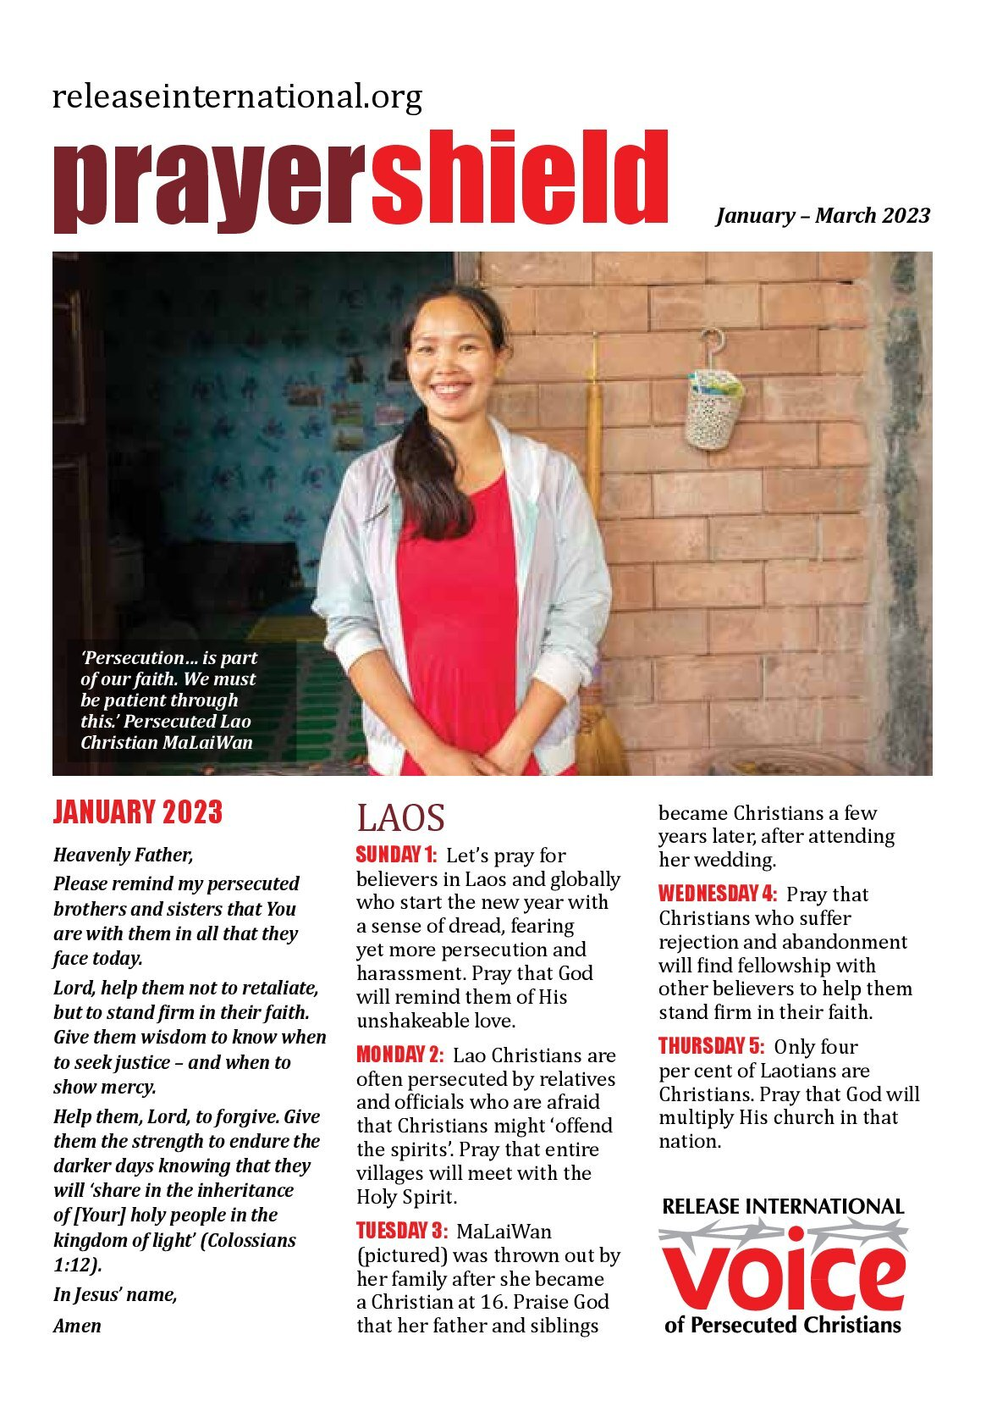
STAY IN TOUCH
Sign up to receive our regular communications by post or email.
Notes:
‘Stay in touch’ slide with QR code linking to website and front cover image of current magazine and prayer shield.

Slide 10
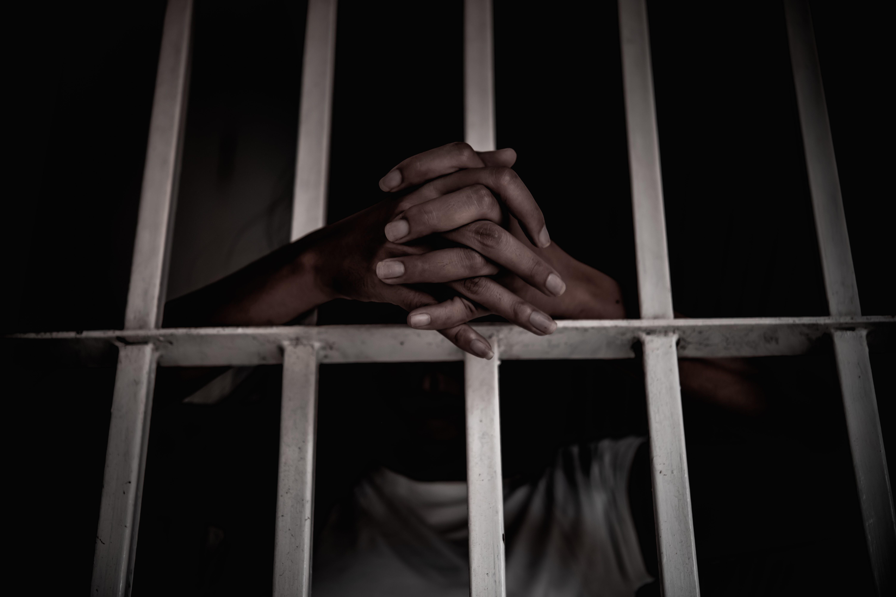
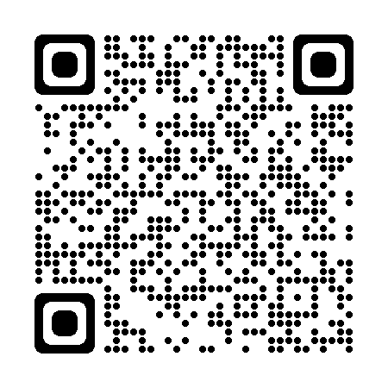
WRITE
Write to a Christian prisoner of faith to assure them they are not forgotten. Prisoner profiles and addresses are available online.
Notes:
Optional call to action slide depending on points of application you want to emphasise. In addition to the ‘stay in touch’ and ‘give’ slides only 2-3 more call to action slides should be used in any one talk.

Slide 11
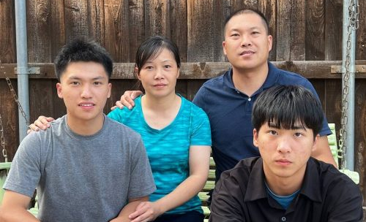
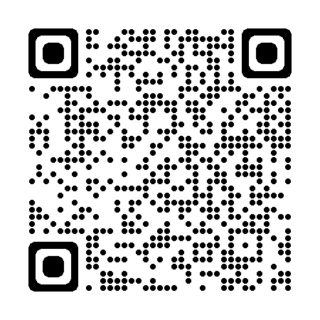
GIVE
Please can you help by making a financial gift.
www.releaseinternational.org/give
Notes:
‘Give’ slide featuring current appeal with QR code to appeal page on website.

Slide 12
www.releaseinternational.org
Notes:
Closing slide with logo, website, and social media icons.

