Slide 1
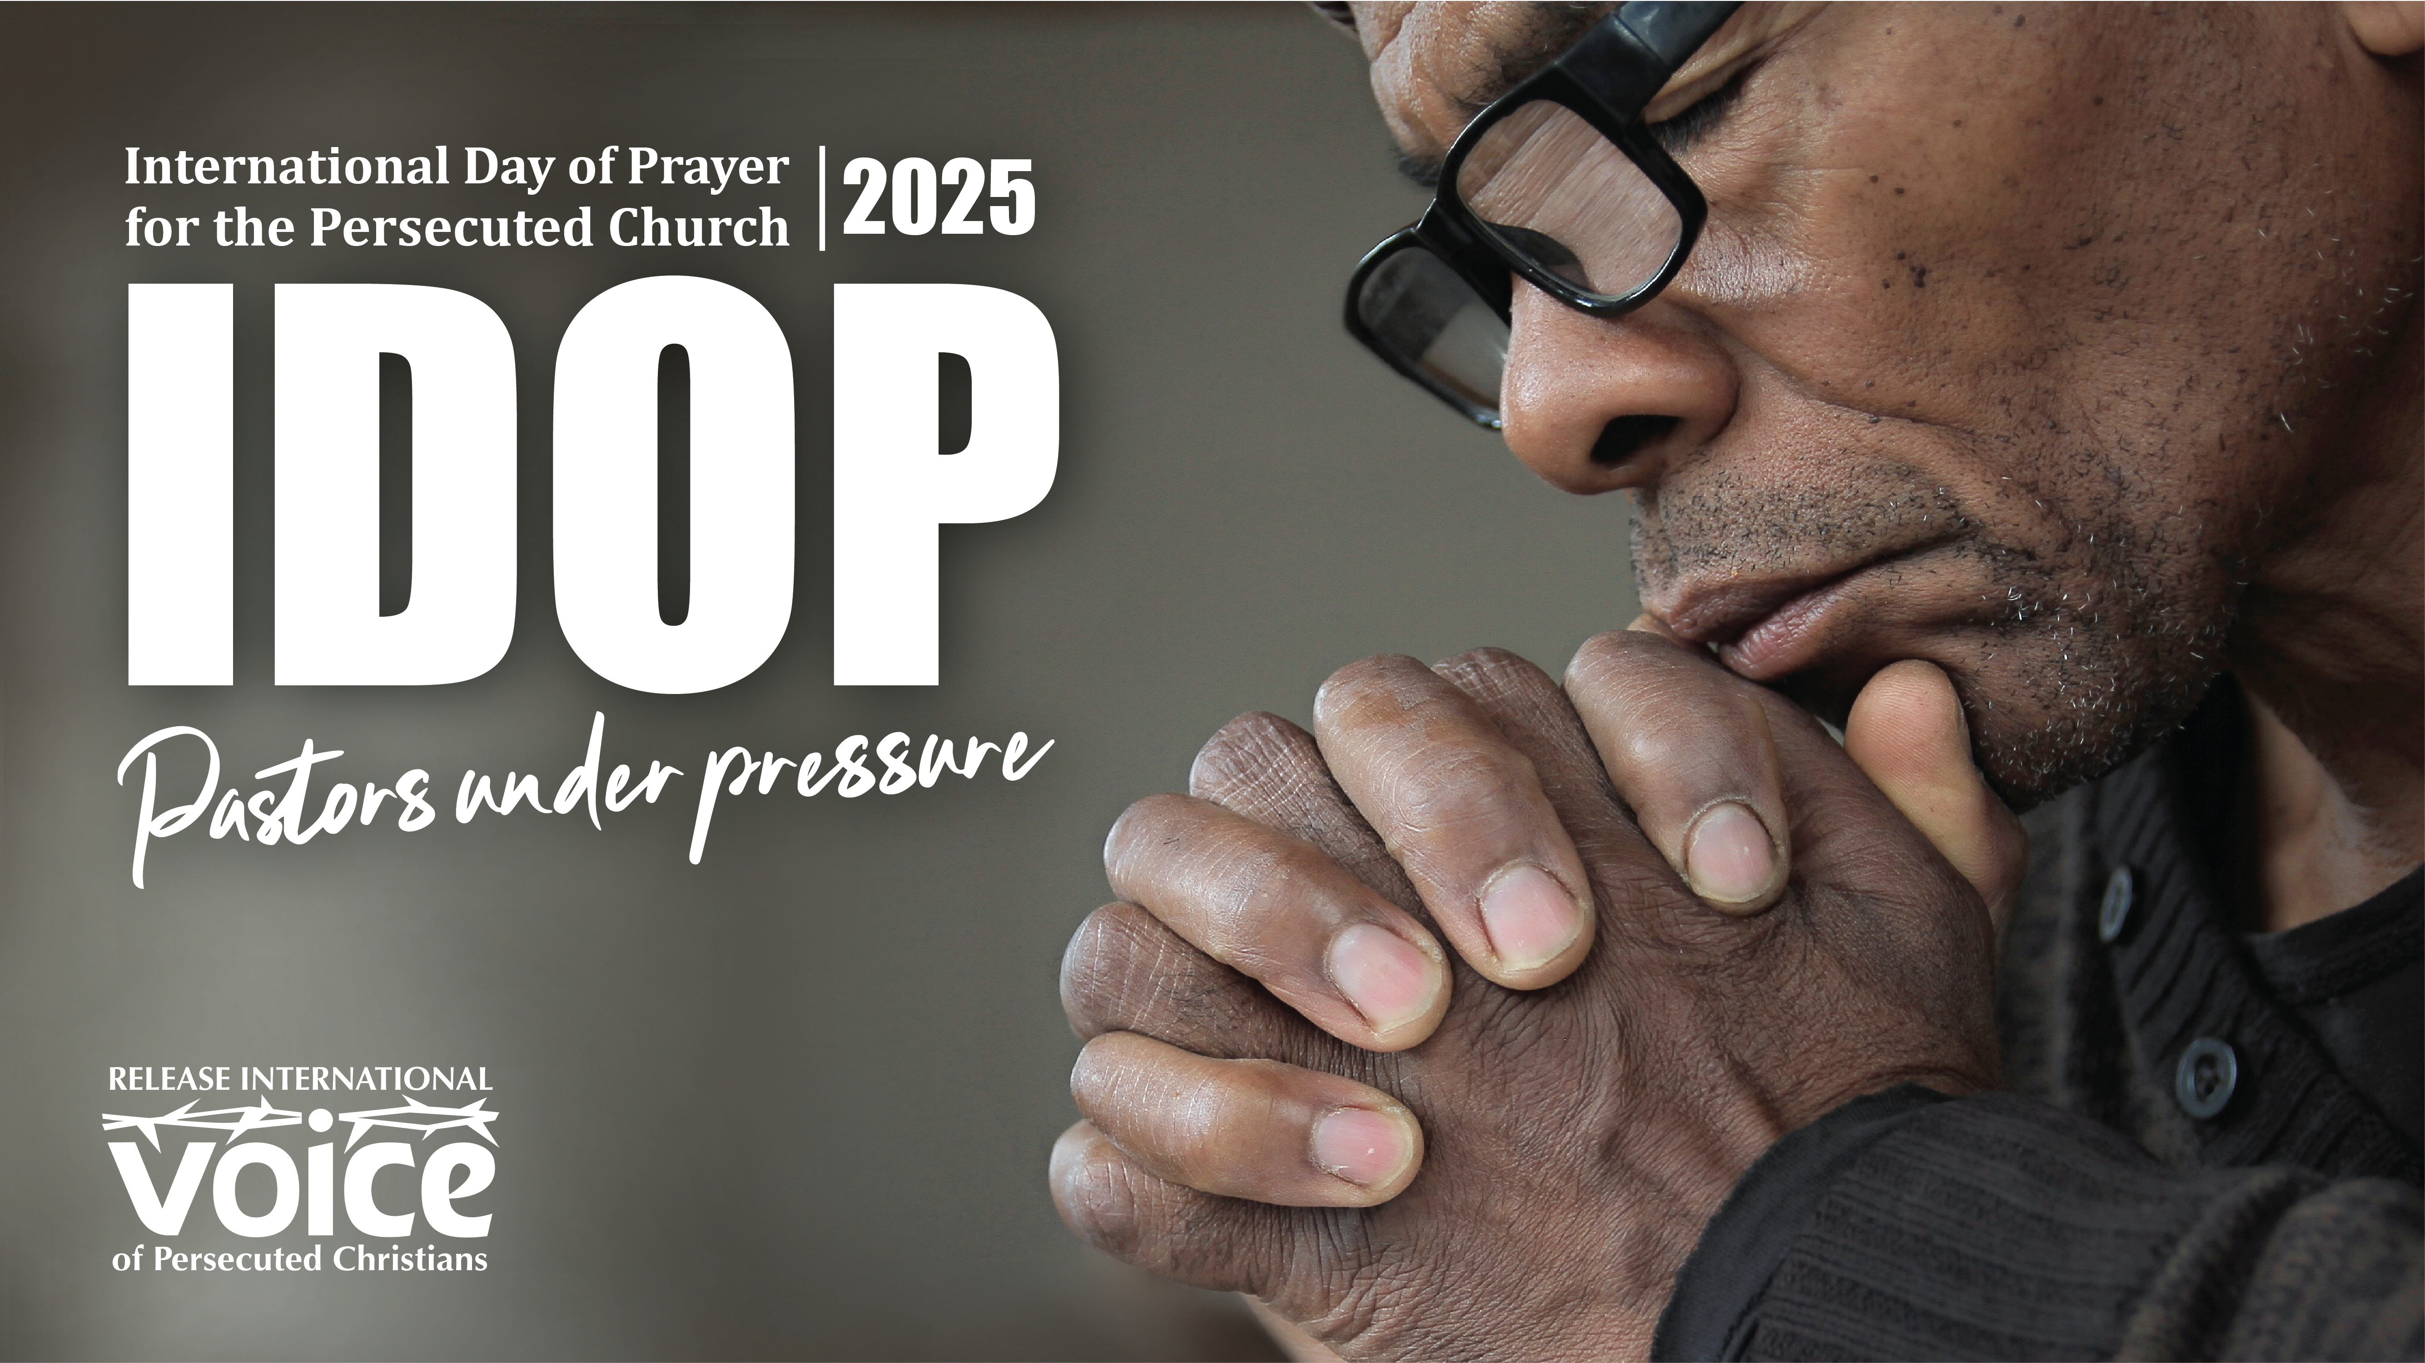

Slide 2
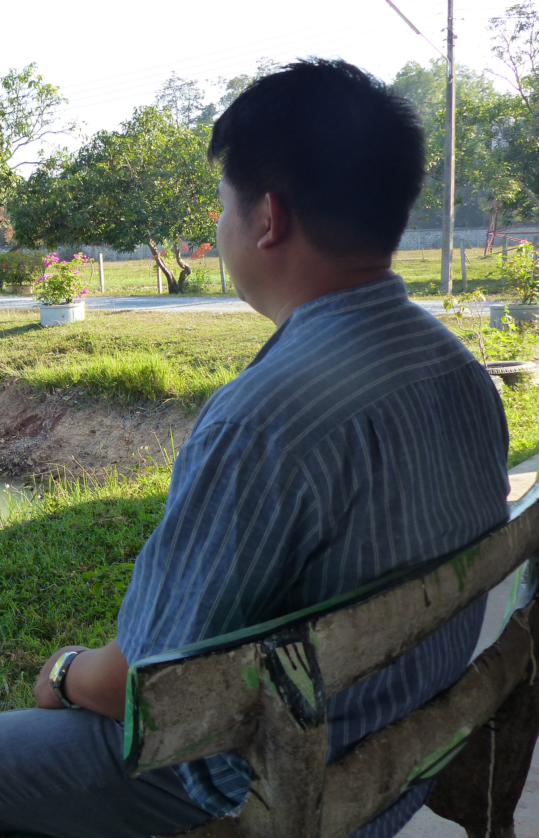



In several countries across the world Christian pastors are under pressure from local mobs, government officials and other religious leaders. As front-line leaders, some face harassment and violent attacks, while others face arrest and imprisonment. This causes stress and material hardship for both the pastor and his family.
Despite these pressures, persecuted pastors are determined to fulfil their calling to preach the gospel and care for God’s people.
Notes:
Small image slide with title and text. All fonts to be Impact or Cambria. Don’t change font size – use multiple slides if required.

Slide 3
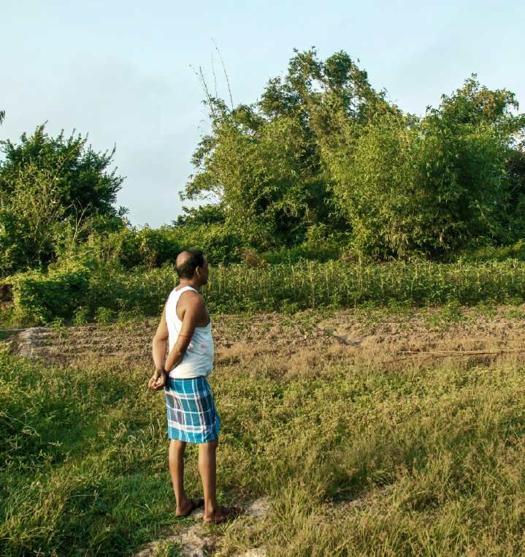
In Sri Lanka Pastor Akashan leads a local church and has trained and nurtured many church workers. However, his ministry is not popular with local residents, who have frequently targeted his building. Seven times the church has been set on fire and seven times Pastor Akashan has worked on his own to restore it. Despite the harassment and danger, he continues his ministry.
Stock image
Notes:
Small image slide with title and text. All fonts to be Impact or Cambria. Don’t change font size – use multiple slides if required.

Slide 4

In India Pastor Mohan was arrested after a crowd of angry extremists surrounded his home. He was accused of breaching anti-conversion laws and remanded in custody for a month. Mohan later returned to his village to lead the church, but he is regularly summoned to court which is expensive and stressful.
Stock image
Notes:
Small image slide with title and text. All fonts to be Impact or Cambria. Don’t change font size – use multiple slides if required.

Slide 5
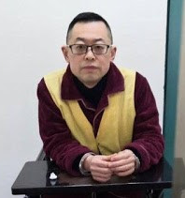
In China Pastor Wang Yi continues to serve a nine-year prison sentence after being convicted of inciting subversion of state power. Before his arrest Wang Yi was vocal about the need for the church to be free from the Communist Party’s control and called on President Xi Jinping and his regime to repent. The outside world knows little about his condition in prison.
Notes:
Small image slide with title and text. All fonts to be Impact or Cambria. Don’t change font size – use multiple slides if required.

Slide 6

⁷ But we have this treasure in jars of clay to show that this all-surpassing power is from God and not from us. ⁸ We are hard pressed on every side, but not crushed; perplexed, but not in despair; ⁹ persecuted, but not abandoned; struck down, but not destroyed. ¹⁰ We always carry around in our body the death of Jesus, so that the life of Jesus may also be revealed in our body. ¹¹ For we who are alive are always being given over to death for Jesus’ sake, so that his life may also be revealed in our mortal body. ¹² So then, death is at work in us, but life is at work in you.
2 Corinthians 4:7-12
Notes:
Bible passage slide with small image if required. Don’t change font size – use multiple slides if required. All fonts to be Impact or Cambria.

Slide 7
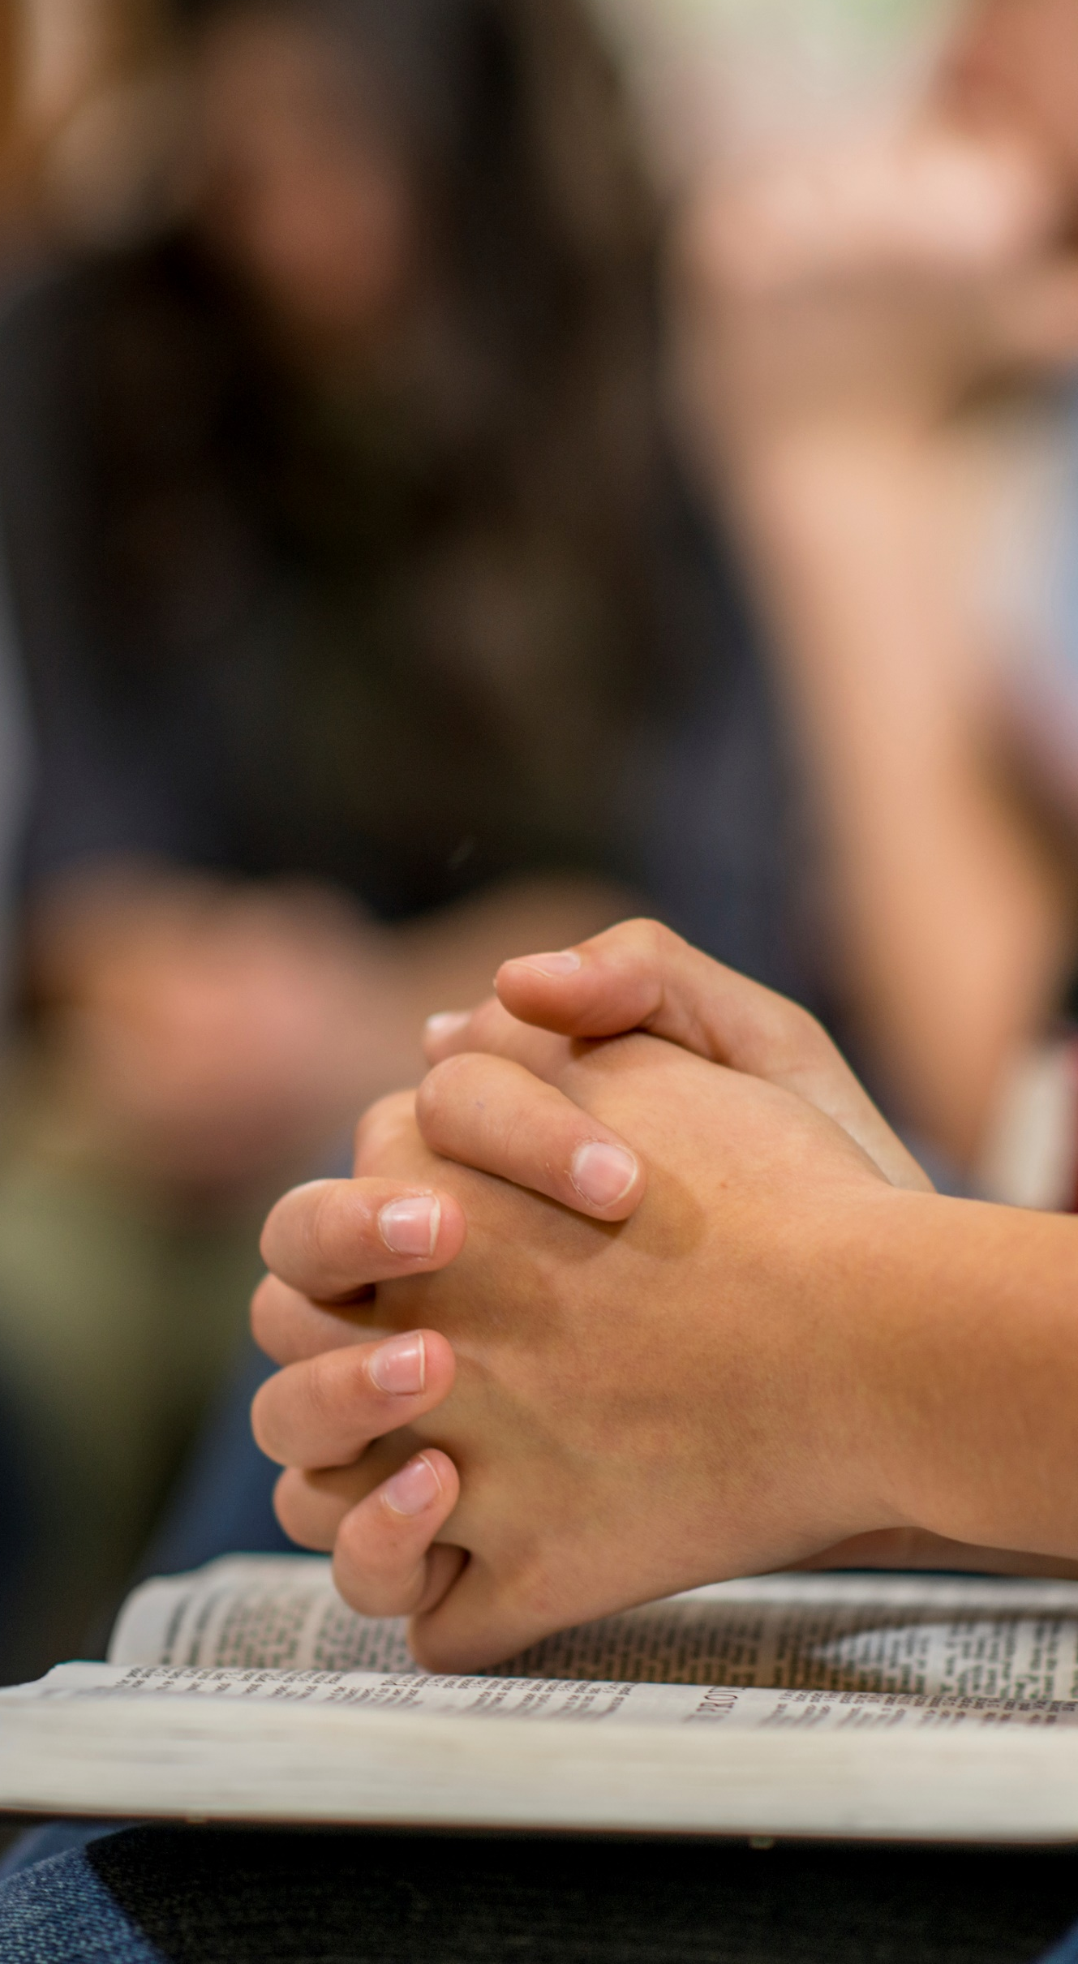
Pray for Christian pastors like Akashan in Sri Lanka, that they will have courage to continue their work despite the threats and intimidation.
Pray that authorities in Sri Lanka would act justly, approve new church building applications, make proper provision for Christian burials, and follow up cases of harassment against Christians.
Notes:
Bible passage slide with small image if required. Don’t change font size – use multiple slides if required. All fonts to be Impact or Cambria.

Slide 8
Pray for Christian pastors like Mohan in India, that they will not be silenced or intimated by the threat of fundamentalist mobs.
Pray against the expansion of anti-conversion laws.
Pray that pastors who have been arrested will get the legal assistance they need to defend themselves.
Notes:
Bible passage slide with small image if required. Don’t change font size – use multiple slides if required. All fonts to be Impact or Cambria.

Slide 9
Pray for Christian pastors like Wang Yi in China who are currently in prison or are awaiting sentencing.
Pray that God will give them courage and confidence in Him; that they will have opportunities to share the gospel with their fellow inmates and guards; and that the Lord will provide for their families.
Notes:
Bible passage slide with small image if required. Don’t change font size – use multiple slides if required. All fonts to be Impact or Cambria.

Slide 10
Pray for Christian pastors in many other countries around the world such as Iran, Eritrea, Nigeria, Laos and Algeria who face daily discrimination, threats of violence, and arrest. Pray that God will sustain their faith and protect their churches.
Pray for the church and its leaders in the UK. Pray that we would make the most of the freedom we have to worship God, share the gospel, and grow our church communities.
Notes:
Bible passage slide with small image if required. Don’t change font size – use multiple slides if required. All fonts to be Impact or Cambria.

Slide 11
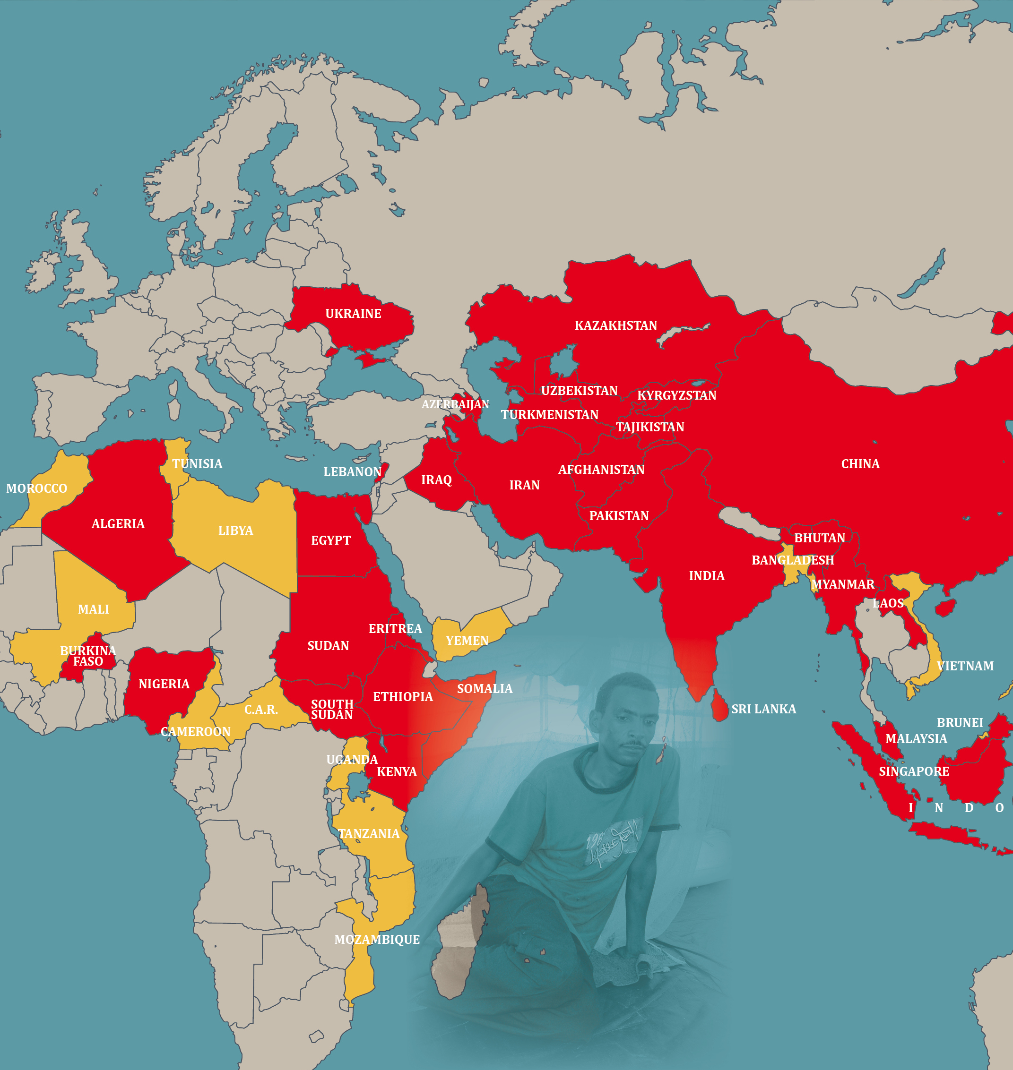
Through our network of international partners Release International is helping to support persecuted Christian pastors and their families prayerfully, pastorally and practically in several countries across the world.
Notes:
Small image slide with title and text. All fonts to be Impact or Cambria. Don’t change font size – use multiple slides if required.

Slide 12


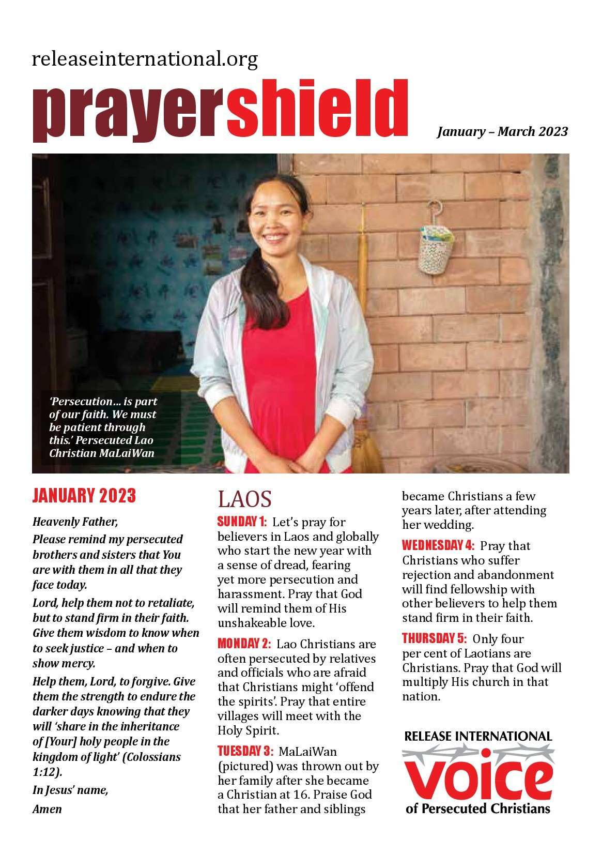
KEEP PRAYING
Sign up to receive our regular communications by post or email.
www.releaseinternational.org
Notes:
‘Stay in touch’ slide with QR code linking to website and front cover image of current magazine and prayer shield.

Slide 13
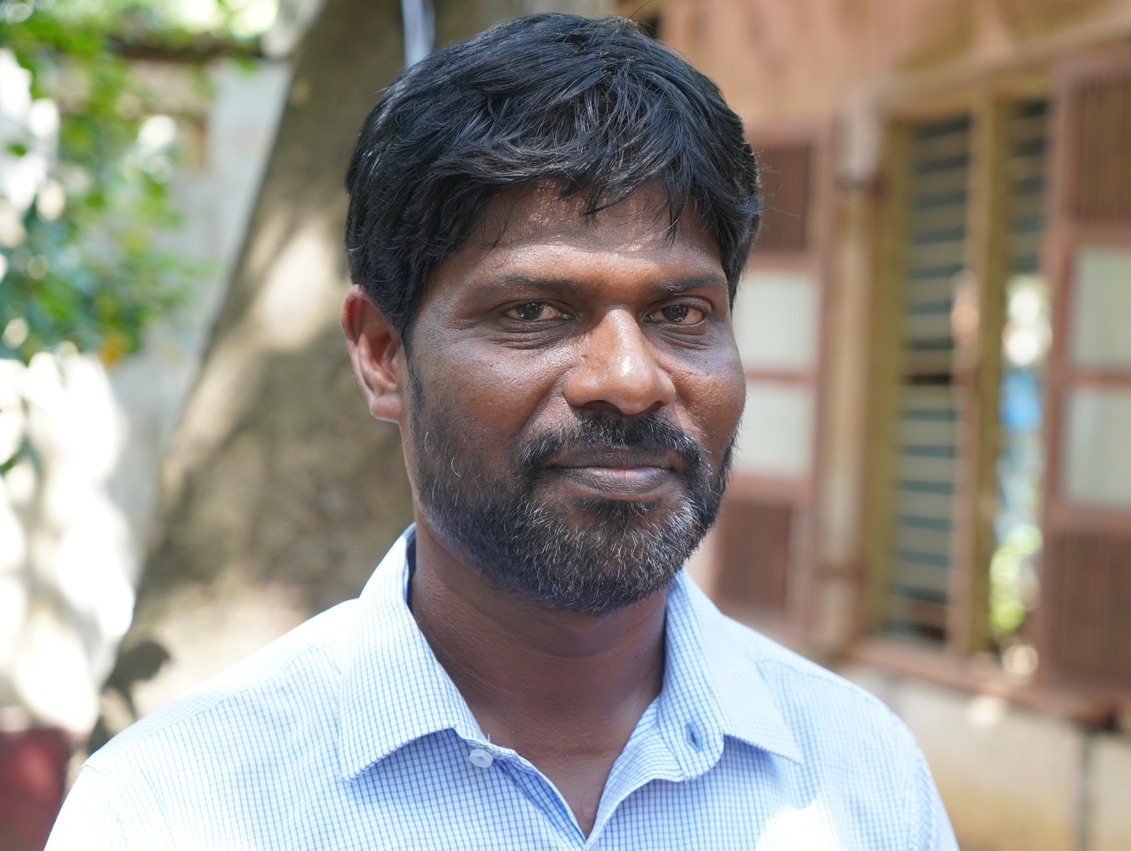

GIVE
Could you help by making a financial gift today.
www.releaseinternational.org
Notes:
‘Give’ slide featuring current appeal with QR code to appeal page on website.

Slide 14







www.releaseinternational.org
Notes:
Closing slide with logo, website, and social media icons.

